Slide 1
MGM Resorts International (MGM) Analyst: Yada So Portfolio Manager: Lien Chau Valuation Date: September 01, 2023

Slide 2
Recommendation
Stock Rating | Hold
Target Price | $41.79
Current Price | $44.35
Downside | -5.76%

Slide 3
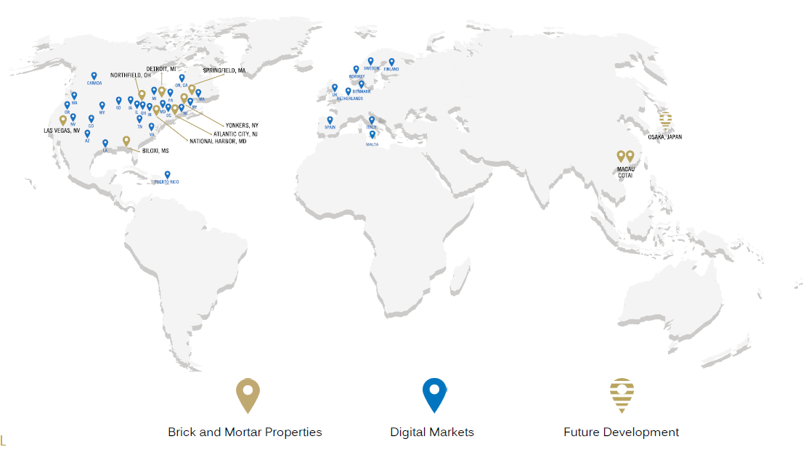
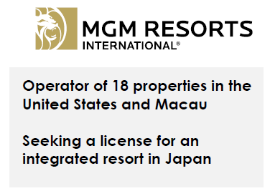
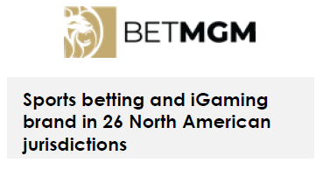
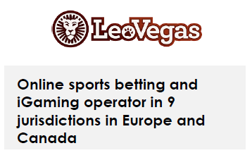
Company Overview
Founded: 1986
Headquarters: Las Vegas, Nevada
Core businesses: Casino, Hotel Rooms,
Food and Beverage, Entertainment,
Online Gaming
Market Cap: ~ 15.6B
FY2022 Revenue: ~13.1B
Employed: ~46,000 (as of Dec 2022)

Slide 4
Revenue
In 2022, Revenue in Macau was only 5%.
Then, increased to 17% in the 1st half of 2023.

Slide 5
Acquisitions (2018-2023)
Sports Betting and iGaming
Resorts and Casinos
Formed BetMGM (2018)
Acquired LeoVegas (2022)
To acquire Push Gaming (Digital Gaming Developer) in 2023
Acquired Empire City (2019)
Acquired the remaining 50% of CityCenter (2021)
Formed JV with Orix to develop a resort in Japan (2021)
Acquired The Cosmopolitan (2022)
Sold Circus Circus (2019), The Mirage (2022), Gold Strike Tunica (2023)
Market share of 16% in Sports Betting and iGaming in the US
Hotel Rooms: ~45,000
Casino Square Footage: ~2.56M
(as of Dec 2022)

Slide 6
Industry Analysis
Gaming Revenue in U.S.
Source: Statista
Source: American Gaming Association
China lifted its zero Covid-19 policy in Feb 2023.
Covid-19 has accelerated the growth of iGaming in the US.

Slide 7
iGaming and Sports Betting in the US
U.S. Supreme Court permitted sports betting in 2018.
In 2022, sports betting is available in 32 states.
Legalization of iGaming is being considered in Indiana, Illinois, New York, and other states.

Slide 8
Number of Visitors and Consumer Sentiment
Source: Las Vegas Convention and Visitors Authority
Source: FRED
From Jan to Jul 2023, # of visitors recovered to 96% of 2019 level.

Slide 9
Porter’s Five Forces
Competitive Rivalry: High
More than 450 commercial casinos in the US
Threat of New Entry: Low
Difficulty in obtaining gaming licenses in each country
Threat of Substitution: High
Increasing number of online gaming sites

Slide 10
Forecasted Revenue
Key Drivers
# of visitors to Las Vegas in 2023 recovered to 96% of 2019 level
# of visitors to Macau in 2023 recovered to 60% of 2019 level
Strong growth in the Sports betting and iGaming industry in the US
The resort in Japan is expected to open in 2030
Negative Factors
Rising interest rates
Fear of economic recession
Historical CAGR of MGM Revenue (2010-2019)
Forecasted CAGR of Industry Revenue (2023-2028)
Forecasted Growth Rate of MGM Revenue (2023-2027)
8.76%
3.1% (Casinos in the World)
4.6% (Hotels in the US)
2024-2027: 3% (World GDP Growth)
2023: ~ 19%

Slide 11
DCF Valuation
Key Assumptions
Growth Rate: 3%
Capex: ~ $300 Million
Valuation
Beta = 2.08
Cost of Equity = 15.54%
Cost of Debt = 8.73%
WACC: 9.61%
Terminal Growth Rate: 2.5%
Target Price
Target Price: $49.31
Current Price: $44.35
Upside: 11.19%

Slide 12
Relative Valuation
P/E Valuation (50%)
Company | Market Cap ($M) | Revenue | Forward P/E | EV/EBITDA
MGM | 15,432.10 | 14,777.70 | 32.26 | 12.64
Caesars | 11,869.90 | 11,417.00 | 14.37 | 7.07
Las Vegas Sands | 41,935.00 | 6,784.00 | 17.18 | 26.23
Wynn Resorts | 11,465.90 | 4,914.20 | 29.50 | 16.38
Boyd Gaming | 6,687.80 | 3,681.10 | 9.86 | 7.85
Penn Entertainment | 3,524.30 | 6,558.70 | 22.08 | 7.23
Melco Resorts | 4,904.20 | 2,243.30 | 6.93 | 58.42
Churchill Downs | 9,379.60 | 2,191.20 | NA | 16.15
Light & Wonder | 6,975.10 | 2,729.00 | 34.13 | 12.54
Median |  |  | 17.18 | 14.35
Median P/E: 17.18
Forecasted EPS: 2.22
Target Price: $38.15
EV/EBITDA (50%)
Median EV/EBITDA: 14.35
Target Price: $30.40
TARGET PRICE
Target Price: $ 34.27
Current Price: $44.35
Downside: 22.72%

Slide 13
Final Valuation
DCF Valuation (50%)
$ 49.31
Relative Valuation (50%)
$34.27
Target Price
PRICE: $ 41.79
DOWNSIDE: 5.76%
(current price: $44.35)
Upside: 11.19%
Downside: 22.72%

Slide 14
Margins, ROA and ROE
Gross margin increased 49% in 2022.
Increase of rent and amortization
→ lower EBITDA and Profit margins, compared with 2019
Increase of rent and amortization → Negative ROA in 2022
Gain related to VICI Transaction and The Mirage sale
→ Positive ROE in 2022

Slide 15
Debt to Equity, Current and Quick Ratios
In 2022, MGM repurchased $2.8 billion of common stock
Sale and leaseback on its real estate assets have improved its liquidity to above 1.5 since 2020

Slide 16
Comparison With Rival Companies
Gross Margin: 2nd lowest > Penn Entertainment
Profit Margin: 2nd highest < Boyd Gaming
Debt to Equity: 2nd highest < Caesars
Current Ratio: 2nd highest < Wynn Resorts

Slide 17
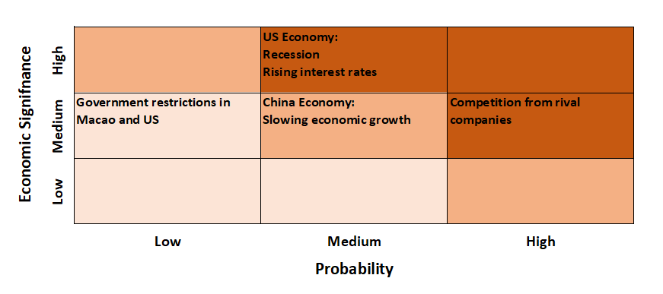
Investment Risk

Slide 18
ESG
Gaming addiction → More government restrictions
Loss of online gaming customer information → Damage to MGM’s reputation and loss of customers
Hurricanes, typhoons or droughts → Disruption to MGM’s operations

Slide 19
Conclusion
Stock Rating | Hold
Target Price | $41.79
Current Price | $44.35
Downside | -5.76%

Slide 20
Appendix

